Slide 1
DATA ENCRYPTION
&
ZERO DOWNTIME

Slide 2
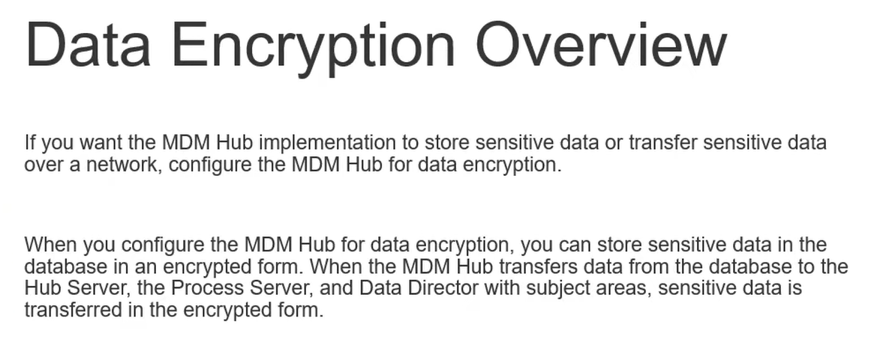

Slide 3
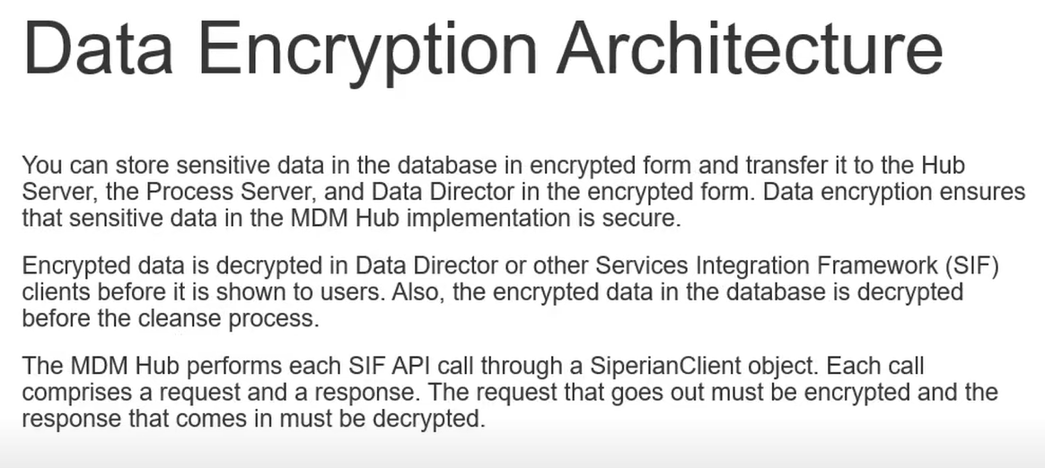

Slide 4
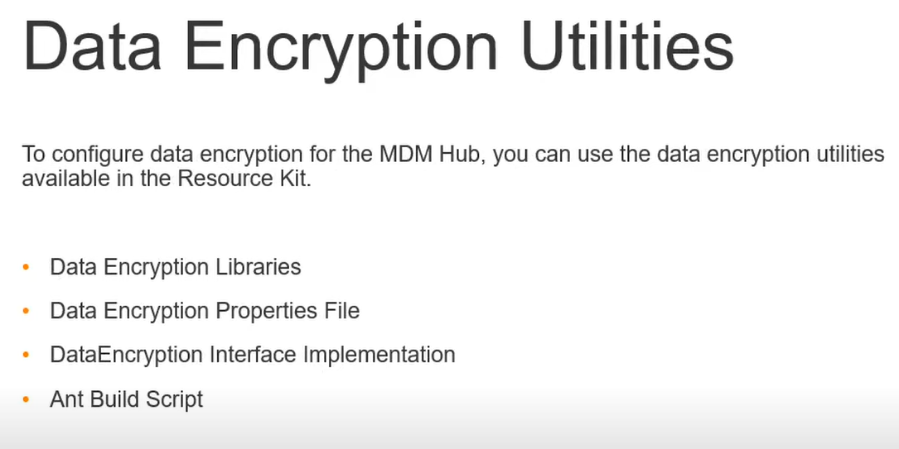

Slide 5
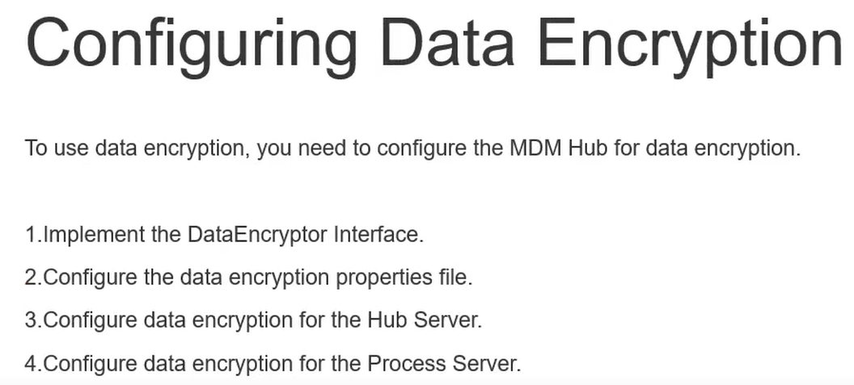

Slide 6
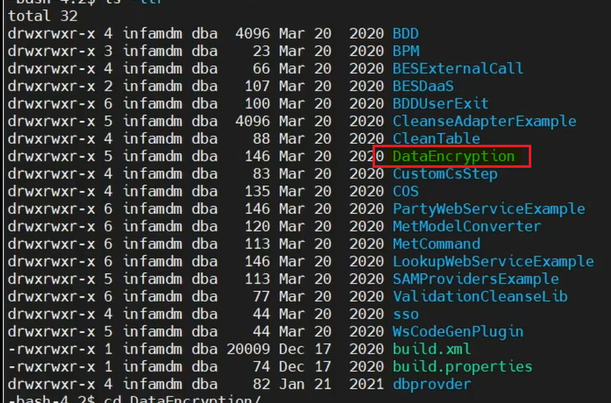
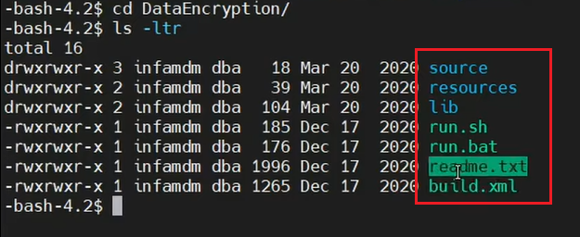

Slide 7
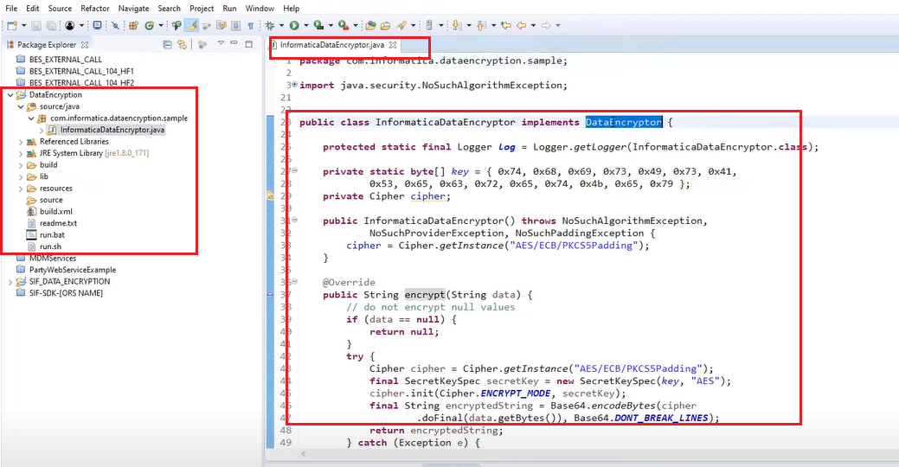

Slide 8
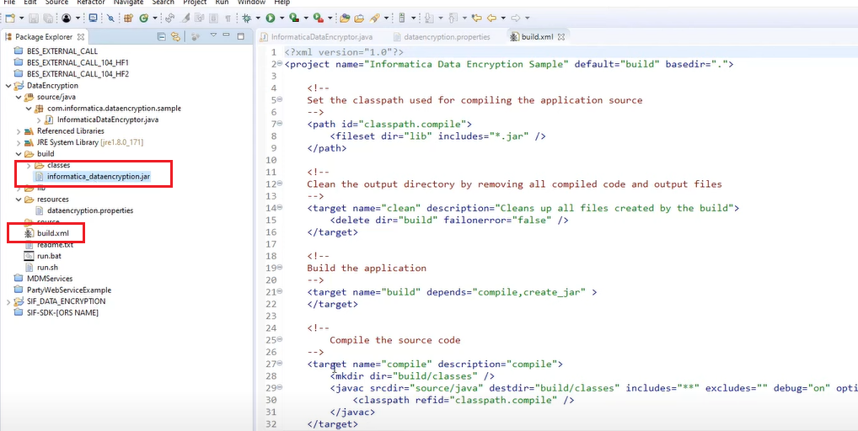

Slide 9
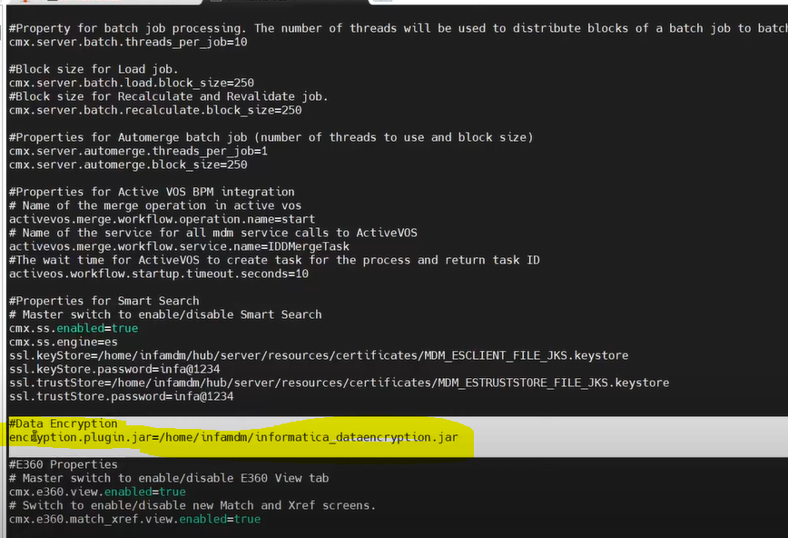
Update the JAR file path in cmxserver.properties file
Do necessary changes EJB client and other files

Slide 10
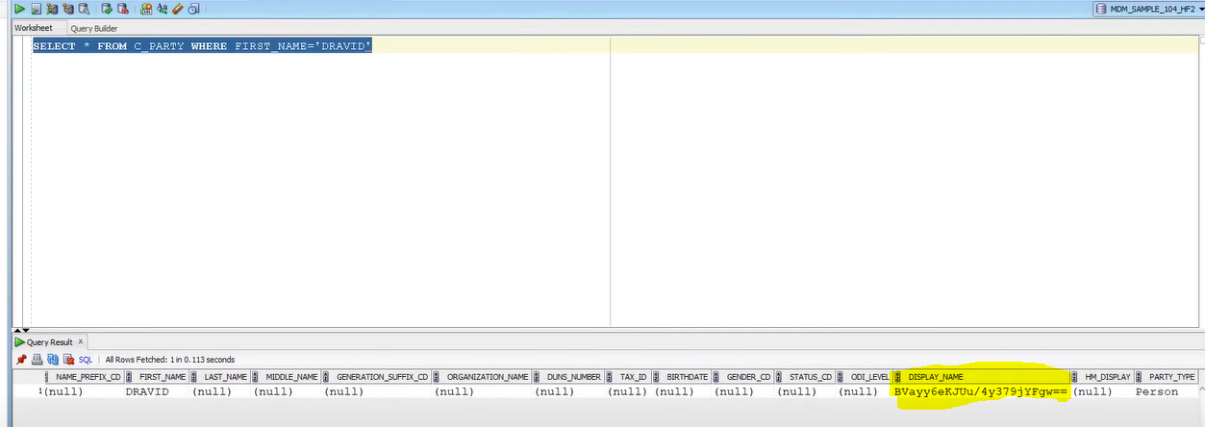
Display Name has been encrypted.

Slide 11
ZERO DOWNTIME

Slide 12
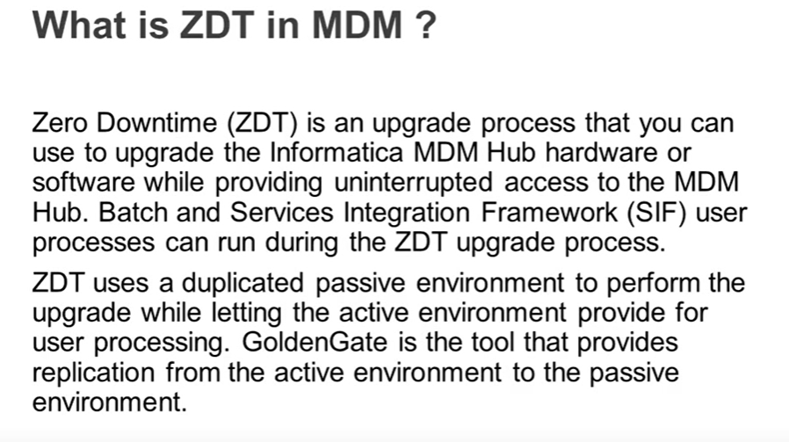

Slide 13
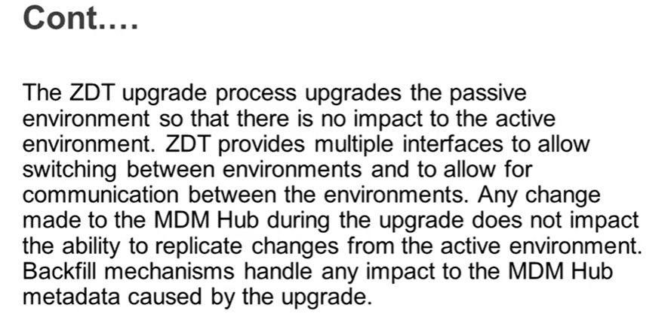

Slide 14
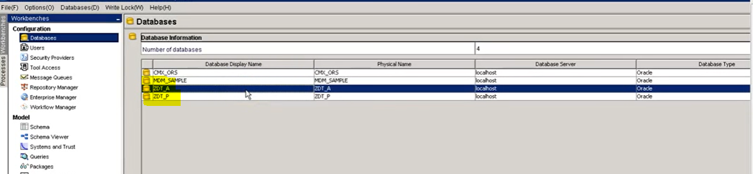
For Demo we have two ORS
ZDT A – Active Env
ZDT P -- Passive Env
Passive Env will automatically get data from Active Env through Oracle Golden Gate software

Slide 15
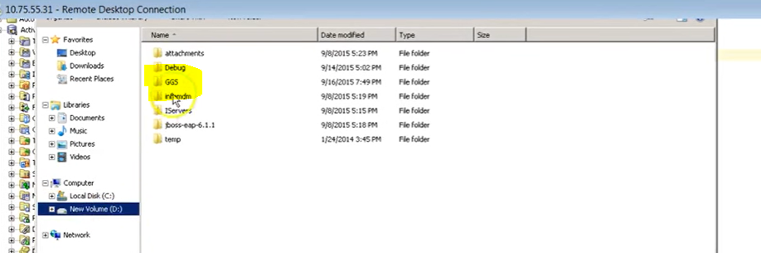
You must install Oracle Golden Gate Software (GGS)
Below is the screenshot where GGS is installed
GGS copies Active Env data to Passive Env

